Slide 1
Module V
Designing IPAddressing in the
Network & Selecting Routing
Protocols
10 hours

Slide 2
Private and Public IPv4 Addresses
Recall from Chapter 1 that the IP address space is divided into public and private spaces. Private addresses are reserved IP addresses that are to be used only internally within a company’s network, not on the Internet.
Private addresses must therefore be mapped to a company’s external registered address when sending anything on the Internet. Public IP addresses are provided for external communication.

Slide 3
Interconnecting Private and Public Addresses
According to its needs, an organization can use both public and private addresses. A router or firewall acts as the interface between the network’s private and public sections.
When private addresses are used for addressing in a network and this network must be connected to the Internet, Network Address Translation (NAT) or Port Address Translation (PAT) must be used to translate from private to public addresses and vice versa.
NAT or PAT is required if accessibility to the public Internet or public visibility is required.

Slide 4
NAT or PAT can be used to translate the following:
■ One private address to one public address:
Used in cases when servers on the internal network with private IP addresses must be visible from the public network. The translation from the server’s private IP address to the public IP address is defined statically.
■ Many private addresses to one public address:
Used for end systems that require access to the public network but do not have to be visible to the outside world.
■ Combination:
It is common to see a combination of the previous two techniques deployed throughout networks.

Slide 5
Determining the Size of the Network
The first step in designing an IP addressing plan is determining the size of the network to establish how many IP subnets and how many IP addresses are needed on each subnet. To gather this information, answer the following questions:
How many locations does the network consist of?: The designer must determine the number and type of locations.
How many devices in each location need addresses?: The network designer must determine the number of devices that need to be addressed, including end systems, router interfaces, switches, firewall interfaces, and any other devices.
What are the IP addressing requirements for individual locations?: The designer must collect information about which systems will use dynamic addressing, which will use static addresses, and which systems can use private instead of public addresses.
What subnet size is appropriate?: Based on the collected information about the number of networks and planned switch deployment, the designer estimates the appropriate subnet size. For example, deploying 48-port switches would mean that subnets with 64 host addresses would be appropriate, assuming one device per port.

Slide 6
Determining the Network Topology
Initially, the designer should acquire a general picture of the network topology; this will help determine the correct information to gather about network size and its relation to the IP addressing plan. With this general network topology information, the designer determines the number of locations, location types, and their correlations.
Planning the IP Addressing Hierarchy
The IP addressing hierarchy influences network routing. This section describes IP addressing hierarchy and how it reduces routing overhead. This section discusses the issues that influence the IP addressing plan and the routing protocol choice, including summarization, fixed-length subnet masking, variable-length subnet masking, and classful and classless routing protocols.

Slide 7
Hierarchical Addressing
The telephone numbering system is a hierarchical system. For example, the North American Numbering Plan includes the country code, the area code, the local exchange, and the line number.
The telephone architecture has handled prefix routing, or routing based only on the prefix part of the address, for many years. For example, a telephone switch in Detroit, Michigan does not have to know how to reach a specific line in Portland, Oregon. It must simply recognize that the call is not local.
A long-distance carrier must recognize that area code 503 is for Oregon, but it does not have to know the details of how to reach the specific line in Oregon.
The IP addressing scheme is also hierarchical, and prefix routing is not new in the IP environment either. As in the telephone example, IP routers make hierarchical decisions.

Slide 8
Route Summarization
With route summarization, also referred to as route aggregation or supernetting, one route in the routing table represents many other routes. Summarizing routes reduces the routing update traffic (which can be important on low-speed links) and reduces the number of routes in the routing table and overall router overhead in the router receiving the routes.
In a hierarchical network design, effective use of route summarization can limit the impact of topology changes to the routers in one section of the network.
Benefits of Route Aggregation
Implementing route aggregation on border routers between contiguously addressed areas controls routing table size. shows an example of implementing route summarization (aggregation) on the area borders in a sample network. If a link within an area fails, routing updates are not propagated to the rest of the network, because only the summarized route is sent to the rest of the network, and it has not changed; the route information about the failed link stays within the area. This reduces bandwidth consumption related to routing overhead and relieves routers from unnecessary routing table recalculation.

Slide 9
Routing Protocol Considerations
With classful routing, routing updates do not carry the subnet mask.
With classless routing, routing updates do carry the subnet mask.
Classful Routing Protocols
As illustrated at the top of Figure , the following rules apply when classful routing protocols
are used:
■ The routing updates do not include subnet masks.
■ When a routing update is received and the routing information is about one of the following:
— Routes within the same major network as configured on the receiving interface, the subnet mask configured on the receiving interface is assumed to apply to the received routes also. Therefore, the mask must be the same for all subnets of a major network.
— Routes in a different major network than configured on the receiving interface, the default major network mask is assumed to apply to the received routes. Therefore, automatic route summarization is performed across major network (Class A, B, or C) boundaries, and subnetted networks must be contiguous.

Slide 10
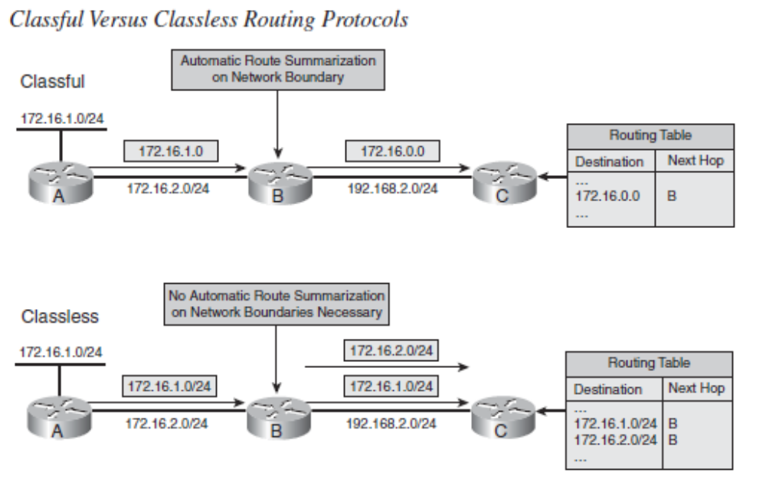
\

Slide 11
Classless Routing Protocols
As illustrated in the lower portion of Figure , the following rules apply when classless routing
protocols are used:
■ The routing updates include subnet masks.
■ Automatic route summarization at the major network boundary is not required, and route summarization can be manually configured.
■ Subnetted networks can be discontiguous.

Slide 12
Methods of Assigning IP Addresses
This section discusses methods of assigning IP addresses to end systems and explains their influence on administrative overhead. Address assignment includes assigning an IP address, a default gateway, one or more domain name servers that resolve names to IP addresses, time servers, and so forth. Before selecting the desired IP address assignment method, the following questions should be answered:
How many devices need an IP address?
Which devices require static IP address assignment?
Is IP address renumbering expected in the future?
Is the administrator required to track devices and their IP addresses?
Do additional parameters (default gateway, name server, and so forth) have to be configured?
Are there any availability issues?
Are there any security issues?

Slide 13
Static Versus Dynamic IP Address Assignment Methods
Following are the two basic IP address assignment strategies:
■ Static: An IP address is statically assigned to a system. The network administrator configures the IP address, default gateway, and name servers manually by entering them into a special file or files on the end system with either a graphical or text interface. Static address assignment is an extra burden for the administrator—especially on large-scale networks— who must configure the address on every end system in the network.
■ Dynamic: IP addresses are dynamically assigned to the end systems. Dynamic address assignment relieves the administrator of manually assigning an address to every network device. Instead, the administrator must set up a server to assign the addresses. On that server, the administrator defines the address pools and additional parameters that should be sent to the host (default gateway, name servers, time servers, and so forth).

Slide 14
Guidelines for Assigning IP Addresses in the Enterprise Network
The typical enterprise network uses both static and dynamic address assignment methods. As shown in Figure , the static IP address assignment method is typically used for campus network infrastructure devices, in the Server Farm and Enterprise Data Center modules, and in the modules of the Enterprise Edge (the E-Commerce, Internet Connectivity, Remote Access and VPN, and WAN and MAN and Site-to-Site VPN modules). Static addresses are required for systems such as servers or network devices, in which the IP address must be known at all times for connectivity, general access, or management.
Dynamic IP address assignment is used for assigning IP addresses to end-user devices, including workstations, Cisco IP phones, and mobile devices.

Slide 15
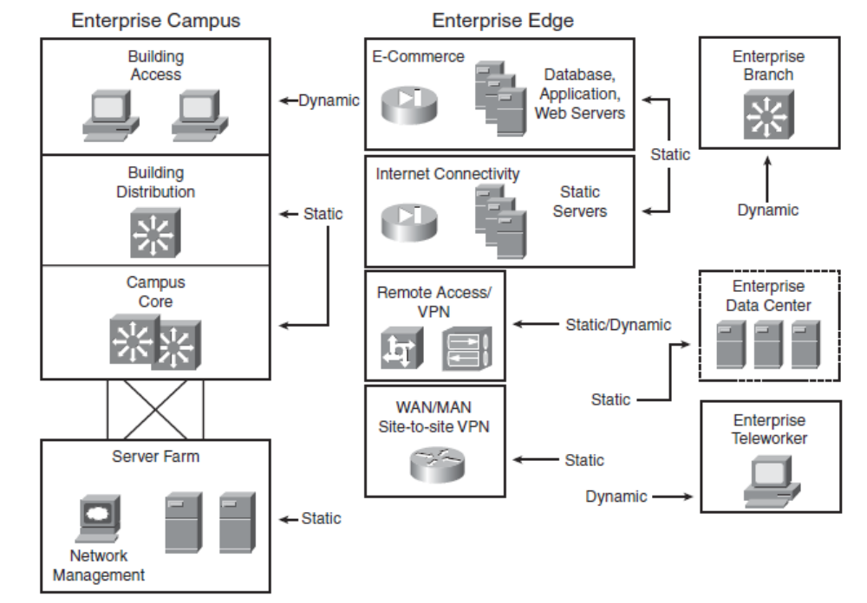

Slide 16
Using DHCP to Assign IP Addresses
DHCP is used to provide dynamic IP address allocation to hosts. DHCP uses a client/server model; the DHCP server can be a Windows server, a UNIX-based server, or a Cisco IOS device. Cisco IOS devices can also be DHCP relay agents and DHCP clients. Figure shows the steps that occur when a DHCP client requests an IP address from a DHCP server.
Step 1 The host sends a DHCPDISCOVER broadcast message to locate a DHCP server.
Step 2 A DHCP server offers configuration parameters such as an IP address, a MAC address, a domain name, a default gateway, and a lease for the IP address to the client in a DHCPOFFER unicast message.
Step 3 The client returns a formal request for the offered IP address to the DHCP server in a DHCPREQUEST broadcast message.
Step 4 The DHCP server confirms that the IP address has been allocated to the client by returning a DHCPACK unicast message to the client.

Slide 17
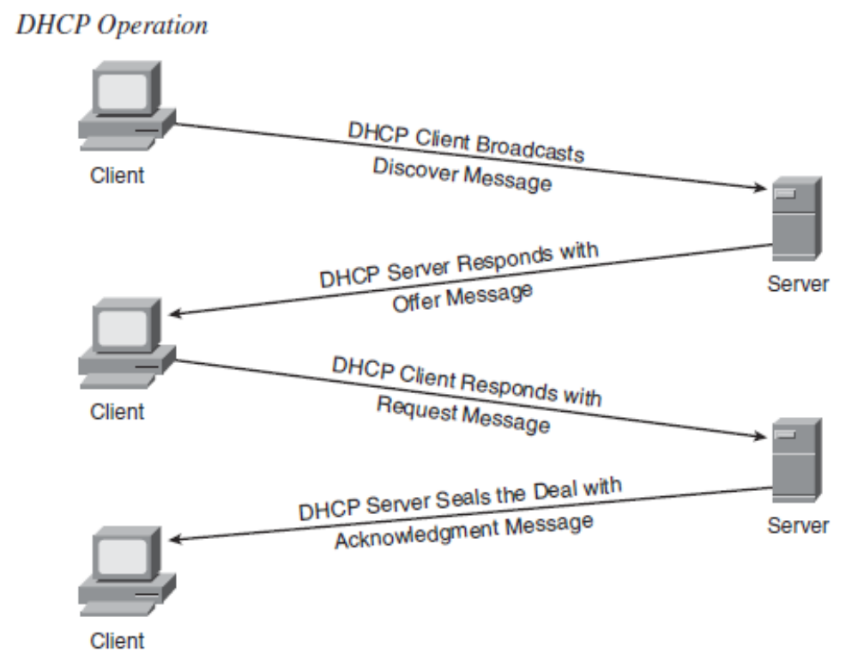

Slide 18
IPv6 Features
Larger address space: IPv6 addresses are 128 bits, compared to IPv4’s 32 bits. This larger addressing space allows more support for addressing hierarchy levels, a much greater number of addressable nodes, and simpler autoconfiguration of addresses.
Globally unique IP addresses: Every node can have a unique global IPv6 address, which eliminates the need for NAT.
Site multihoming: IPv6 allows hosts to have multiple IPv6 addresses and allows networks to have multiple IPv6 prefixes. Consequently, sites can have connections to multiple ISPs without breaking the global routing table.
Header format efficiency: A simplified header with a fixed header size makes processing more efficient.
Improved privacy and security: IPsec is the IETF standard for IP network security, available for both IPv4 and IPv6. Although the functions are essentially identical in both environments, IPsec is mandatory in IPv6. IPv6 also has optional security headers.
Flow labeling capability: A new capability enables the labeling of packets belonging to particular traffic flows for which the sender requests special handling, such as nondefault quality of service (QoS) or real-time service.

